Slide 1
Thinking Critically

Slide 2
Is Your Ox Being Gored?
Objectively false beliefs:
The Earth isn’t warming
If the Earth is warming, it isn’t caused by humans
Vaccines cause autism, or are otherwise unsafe
Cellphones cause cancer
Living near power lines or cell towers is harmful
Intelligent design / creation science
Acupuncture / homeopathy / chiropractic / detoxification / naturopathy
Dowsing / witching
Organic foods are healthier than conventional foods
Gluten sensitivity is common
GMOs are unhealthy or harmful
Notes:
Objective: largely based on facts, on evidence, on what is measureable, on what is observable
Subjective: largely based on opinions, on emotions

Slide 3
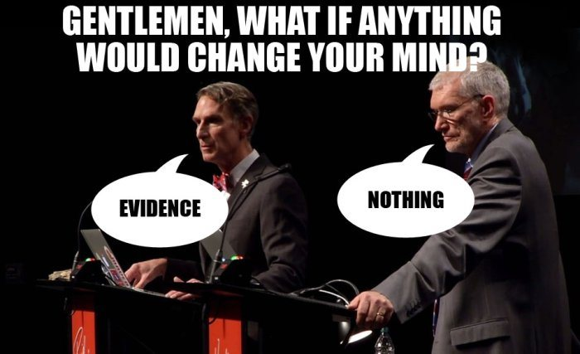
Are you willing to honestly evaluate your beliefs?
Are you willing to change your mind?

Slide 4
Epistemology
/əˌpistəˈmäləjē/
noun PHILOSOPHY
the theory of knowledge, especially with regard to its methods, validity, and scope. Epistemology is the investigation of what distinguishes justified belief from opinion.
Notes:
Epistemology deals with the ways that we obtain knowledge. What knowledge is, what belief is, what justifies the two.

Slide 5
Epistemology
Evidence-based: belief is based on the relative weight of objective evidence
Faith-based: belief is based on indoctrinated ideas, on the acceptance of ideas from trusted parties, on dogma

Slide 6
You cannot accurately assess news if you can’t think critically.
Critical thinking is a learned skill!

Slide 7
Be skeptical.
Skepticism isn’t doubt, but an openess to changing your beliefs.
Notes:
Very important not to confuse meaning of skepticism as “doubt” with the meaning in its critical thinking sense!

Slide 8
Weigh objective evidence.
Belief isn’t binary. Better evidence warrants stronger belief.
Notes:
This is related to the Black/White fallacy.
Skepticism doesn’t demand that all viewpoints have equal weight!

Slide 9
Respect expert opinion.
Respect expert consensus.
Notes:
An expert in “A” may not be an expert in “B”.
This is related to the Appeal to Authority fallacy.

Slide 10
Cognitive Biases
Confirmation bias
Belief bias
Backfire effect (denialism)
Bandwagon effect
Reactance
Authority bias
Illusion of truth effect
Notes:
Confirmation bias: The tendency to search for, interpret, focus on and remember information in a way that confirms one's preconceptions.
Belief bias: An effect where someone's evaluation of the logical strength of an argument is biased by the believability of the conclusion.
Backfire effect: The reaction to disconfirming evidence by strengthening one's previous beliefs.
Bandwagon effect: The tendency to do (or believe) things because many other people do (or believe) the same.
Reactance: The urge to do the opposite of what someone wants you to do out of a need to resist a perceived attempt to constrain your freedom of choice.
Authority bias: The tendency to attribute greater accuracy to the opinion of an authority figure (unrelated to its content) and be more influenced by that opinion.
Illusion of truth effect: A tendency to believe that a statement is true if it is easier to process, or if it has been stated multiple times, regardless of its actual veracity.

Slide 11
Logical Fallacies
Argument from ignorance
Slippery slope
Black-or-white
False cause
Ad hominem
Appeal to authority
Shifting the burden of proof
Cherry picking
Tu quoque
Notes:
Argument from ignorance: Assuming that a claim is true because it has not been or cannot be proven false, or vice versa.
Slippery slope: Asserting that a relatively small first step inevitably leads to a chain of related events.
Black-or-white: Two alternative statements are held to be the only possible options, when in reality there are more.
False cause: Presuming that a real or perceived relationship between things means that one is the cause of the other.
Ad hominem: Attacking the arguer instead of the argument. Not always a fallacy (Kierkegaard on Martensen: “My opponent is a glob of snot.”
Appeal to authority: Where an assertion is deemed true because of the position or authority of the person asserting it.
Shifting the burden of proof: I need not prove my claim, you must prove it is false.
Cherry picking: Pointing at individual cases or data that seem to confirm a particular position, while ignoring a significant portion of related cases or data that may contradict that position.
Tu quoque: A certain position is false or wrong or should be disregarded because its proponent fails to act consistently in accordance with that position.

Slide 12
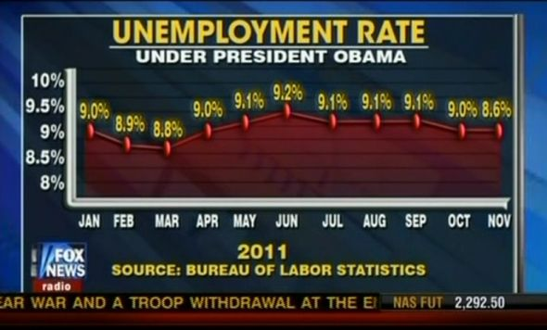
Graphical Data
Notes:
This is nearly flat… and the last point is misplotted. Note limited y-axis.

Slide 13
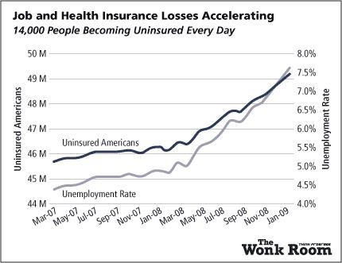
Graphical Data
Notes:
Note independent dual y-axes. What does the crossover point mean? Also, note narrow range

Slide 14
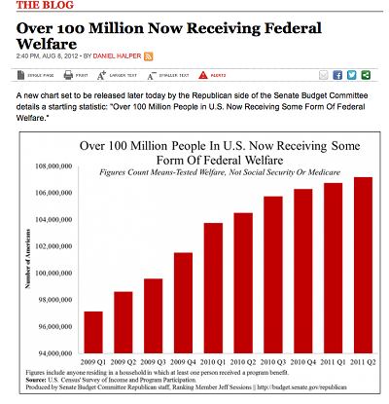
Graphical Data
Notes:
Narrow y-axis amplifies apparent impact.

Slide 15
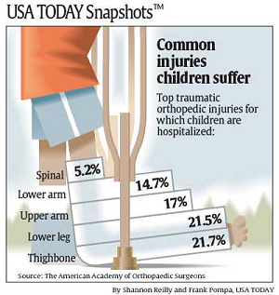
Graphical Data
Notes:
For spinal, the real figure is about .0000003% (based on 2000 injuries per year out of a population of around 74,000,000).

Slide 16
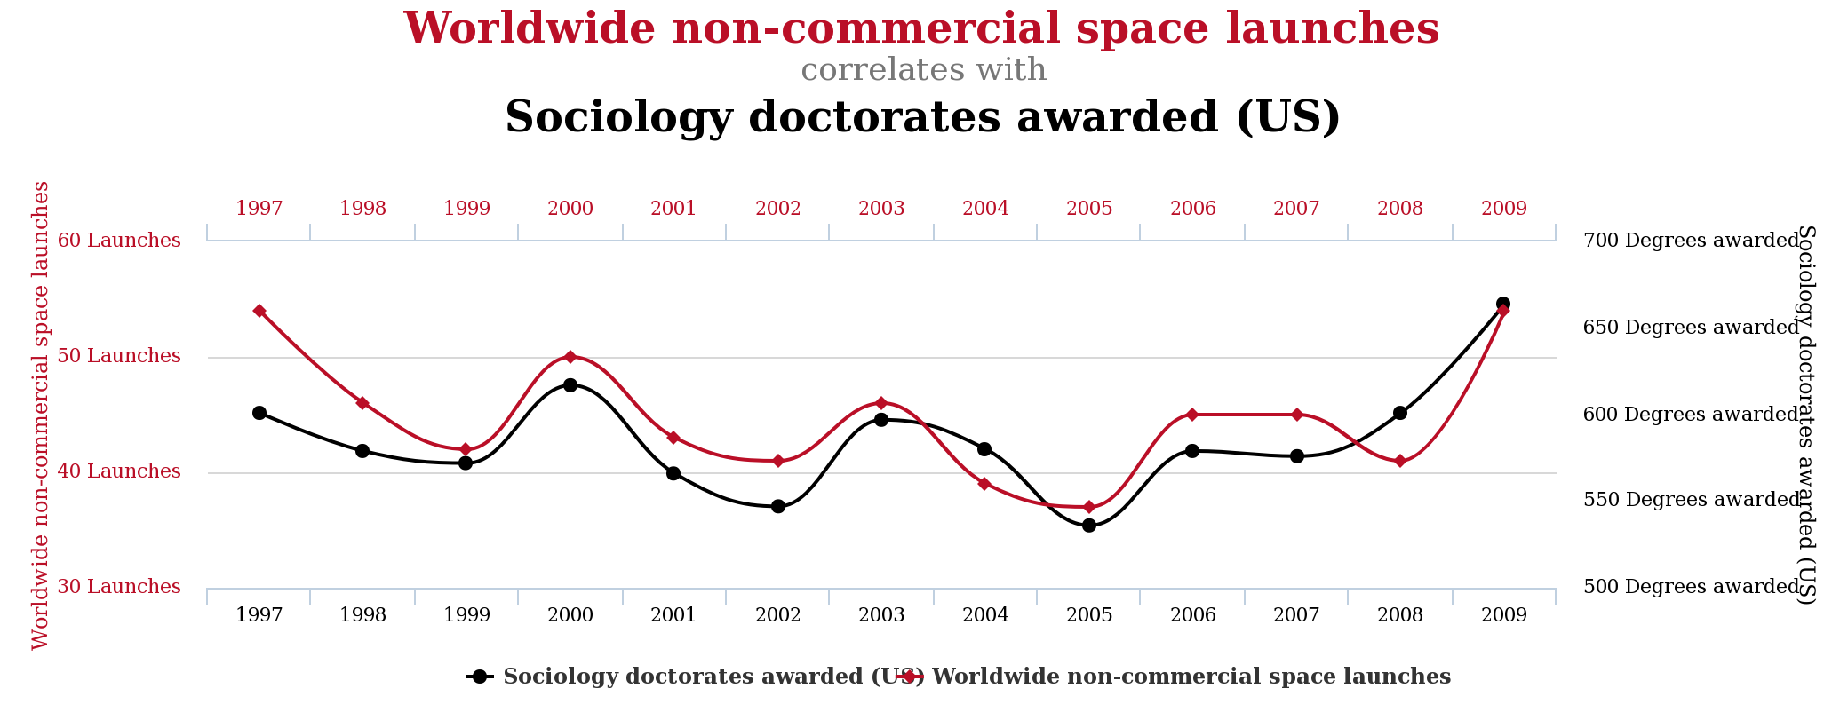
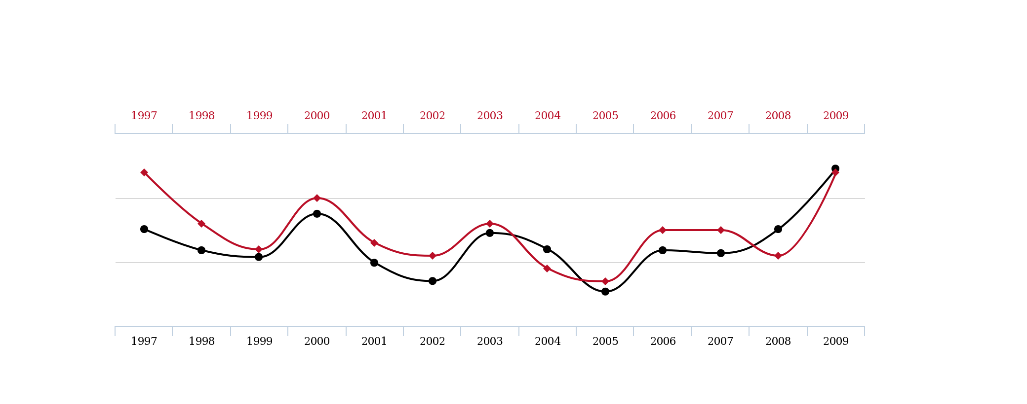
Correlation
vs.
Causation
Notes:
It is extremely easy to show an apparent correlation between unrelated things.

Slide 17
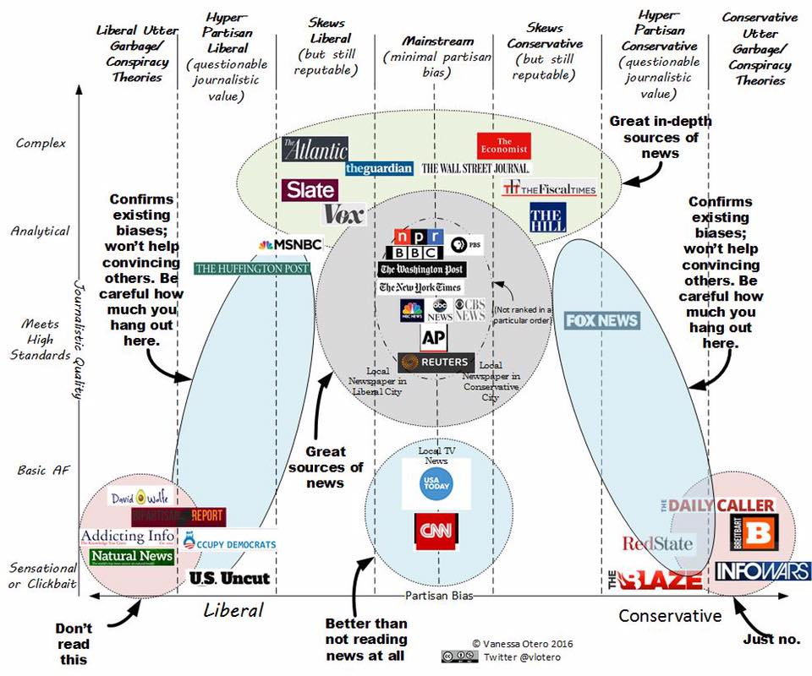
Consider Sources

Slide 18
Fact Checking
Is the source real and reputable?
Read the story!
Check out the author
Look at quotes; check them
Read comments
Check sources
Look for independent accounts
Does the data make sense?
Be aware of your biases
Use experts: Snopes, FactCheck, PolitiFact, WP Fact Checker, MediaBiasFactCheck
Notes:
Good sites: .GOV, .EDU, Wikipedia, major journals.

Slide 19
